Slide 1
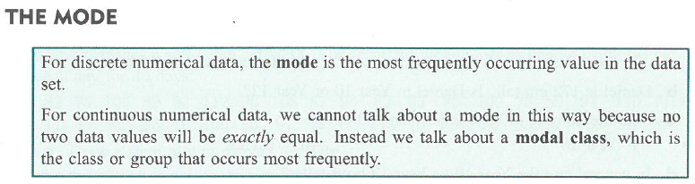

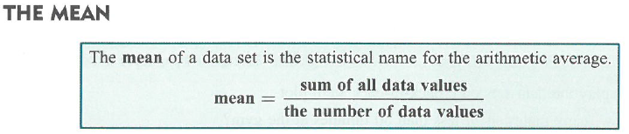

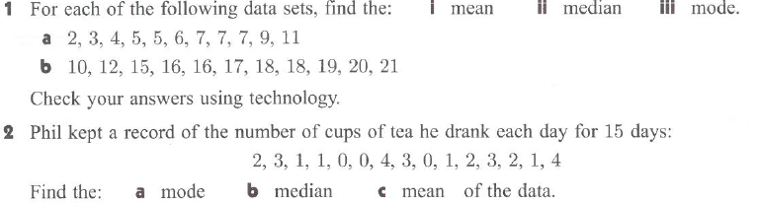
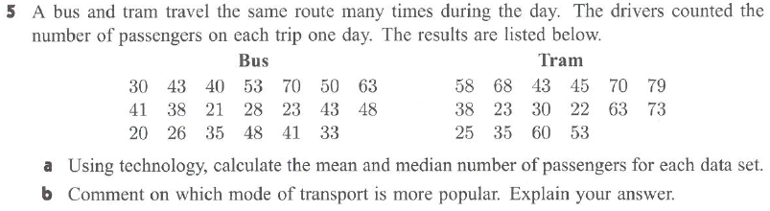
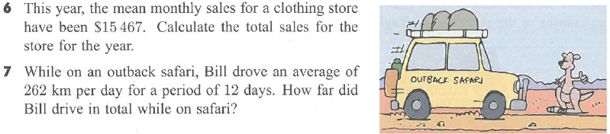

Slide 2
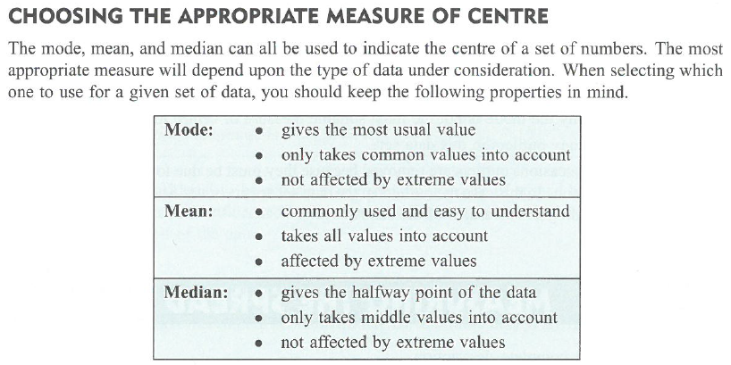
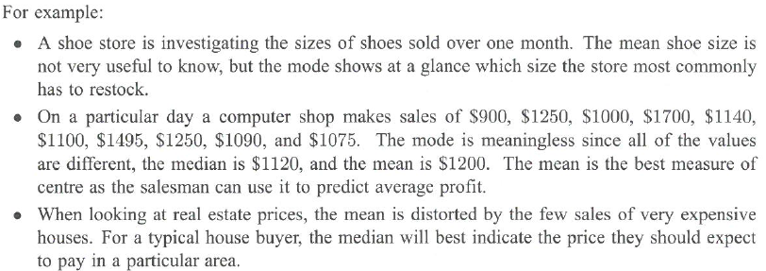
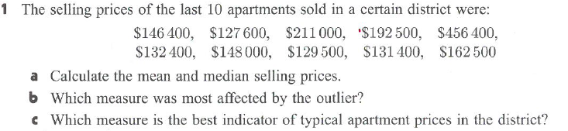
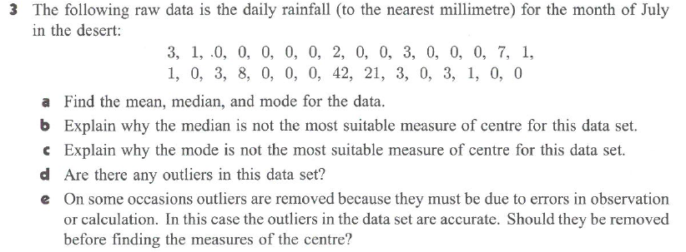

Slide 3
Answers
1. a i6 ii 6 iii7
B i16.5 ii17 iii16 and 18
2a 1 cup b 2 cups c 1.8 cups
5 a bus : mean=39.7 median=40.5
tram mean=49.1 median=49
b tram data has higher mean and median but as there are fewer tram trips per day the bus is more popular
6 $185604
7 3144km
1 a mean $183 770 median $147200
b mean
c median
3 a mean=3.19mm median=0 mm mode = 0mm
b – median not central as most values = 0
c most common value = 0
d yes, 21mm and 42 mm
e no – valid data must be included

